Slide 1
Data Presentations (1)
Md. Ismail Hossain Riday

Slide 2
What is Data Presentation
It is a process of organizing, summarizing, and visual representation of data
Which is easy to understandable and interpretable

Slide 3
What is Data Presentation
Case ID | Gender | Wealth Status | Education
01 | Male | Middle | No education
02 | Female | Middle | Primary
03 | Female | Poor | Primary
04 | Male | Rich | Higher
… | … | … | …
… | … | … | …
8000 | Male | Poor | No education

Slide 4
What is Data Presentation
Male
Female
Male | 56.3%
Female | 43.7%

Slide 5
How to present…
Frequency distribution
Graphical representation

Slide 6
Frequency distribution
It is a statistical tabulated representation process
of the number of occurrence
of each class/category
Arranging data into homogeneous/similar group

Slide 7
Frequency distribution
For example, collects blood group from 10 students,
O, A, B, O, AB, B, A, A, A, AB
How many homogeneous groups are there in this data?
O | 2
A | 4
B | 2
AB | 2
FREQUENCY

Slide 8
Class Work
Student, Student, Public service, Businessman, Day labor, Public service, Private service, Day labor, Student, Public service, Public service, Private service, Businessman, Day labor, Businessman, Private service, Businessman, Public service, Private service, Public service.
Businessman | 4
Day Labor | 3
Private service | 4
Public service | 6
Student | 3
Total | 20

Slide 9
Types of FD
Frequency distribution of Quantitative data
Frequency distribution of Qualitative data

Slide 10
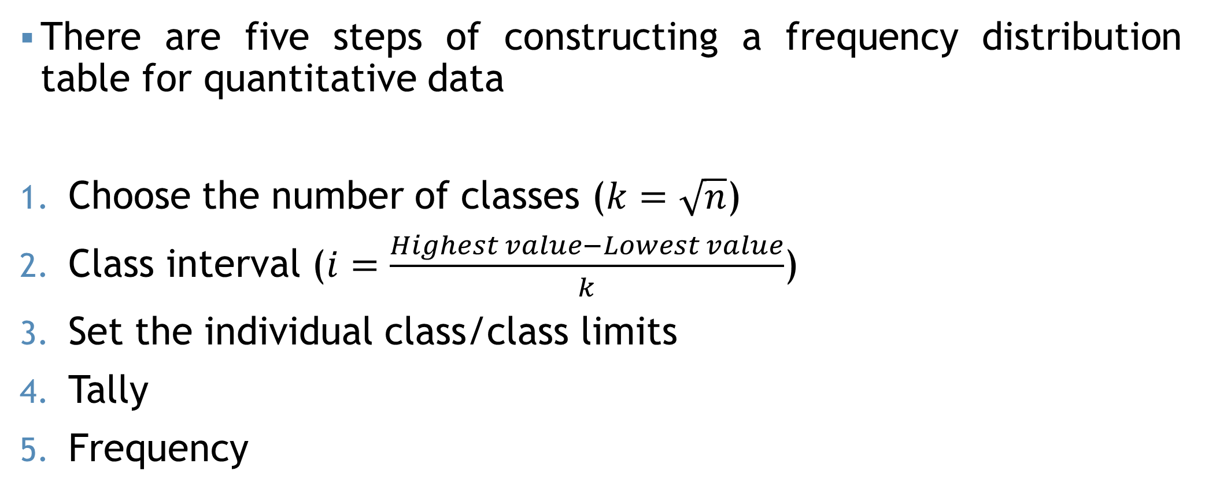
FD for Quantitative
There are five steps of constructing a frequency distribution table for quantitative data
Choose the number of classes ($k=\sqrt{n}$)
Class interval ($i=\frac{Highest value−Lowest value}{k}$)
Set the individual class/class limits
Tally
Frequency

Slide 11
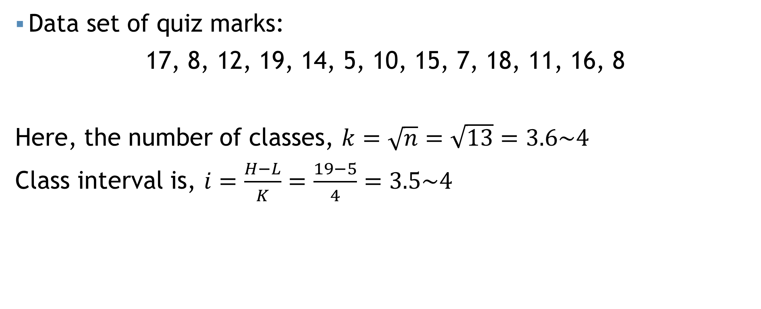
FD for Quantitative
Data set of quiz marks:
17, 8, 12, 19, 14, 5, 10, 15, 7, 18, 11, 16, 8
Here, the number of classes, $k=\sqrt{n}=\sqrt{13}=3.6\sim 4$
Class interval is, $i=\frac{H−L}{K}=\frac{19−5}{4}=3.5\sim 4$
Class | Tally | Frequency
5-9 | |||| | 4
9-13 | ||| | 3
13-17 | ||| | 3
17-21 | ||| | 3

Slide 12
Self Practice!!!
A manager of certain computer selling company wants to study the computer selling behavior in his company. The following data give the number of computers sold by the company for a sample of 15 days.
38, 52, 27, 65, 44, 31, 72, 58, 20, 75, 49, 63, 35, 41, 69

Slide 13
Self Practice!!!
Below given the total monthly income (in thousand taka) of 30 randomly selected families-
30, 40, 5, 110, 11, 15, 55, 20, 120, 45, 30, 47, 52, 68, 105, 62, 52, 98, 76, 85, 83, 91, 49, 38, 57, 27, 23, 42, 9, 65
Construct frequency distribution table using class (5 to below 25), (25 to below 45), and so on.

Slide 14
FD for Quantitative
Class | Tally | Frequency
5-9 | |||| | 4
9-13 | ||| | 3
13-17 | ||| | 3
17-21 | ||| | 3
Class: Raw data are assigned to some chosen group of appropriate size.
Frequency: The number of observations or values falling into each group/class
Class limits: The frequencies of a particular class are bounded by two values.
Class width/interval: Length of the class

Slide 15
FD for Quantitative
Class | Tally | Frequency
5-9 | |||| | 4
9-13 | ||| | 3
13-17 | ||| | 3
17-21 | ||| | 3

Slide 16
FD for Quantitative
Relative frequency: Ratio between the frequency of that category and the total number of observations
Class | Tally | Frequency | Relative frequency
5-9 | |||| | 4
9-13 | ||| | 3
13-17 | ||| | 3
17-21 | ||| | 3

Slide 17
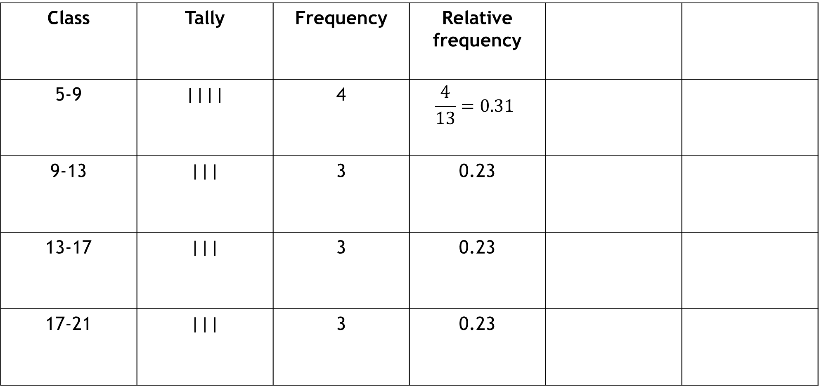
FD for Quantitative
Class | Tally | Frequency | Relative frequency
5-9 | |||| | 4 | $$\frac{4}{13}=0.31$$
9-13 | ||| | 3 | 0.23
13-17 | ||| | 3 | 0.23
17-21 | ||| | 3 | 0.23

Slide 18
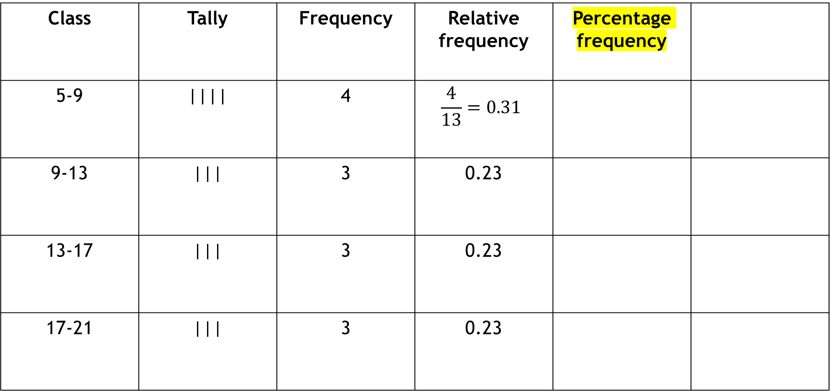
FD for Quantitative
Percentage frequency: Multiply Relative frequency by 100
Class | Tally | Frequency | Relative frequency | Percentage frequency
5-9 | |||| | 4 | $$\frac{4}{13}=0.31$$
9-13 | ||| | 3 | 0.23
13-17 | ||| | 3 | 0.23
17-21 | ||| | 3 | 0.23

Slide 19
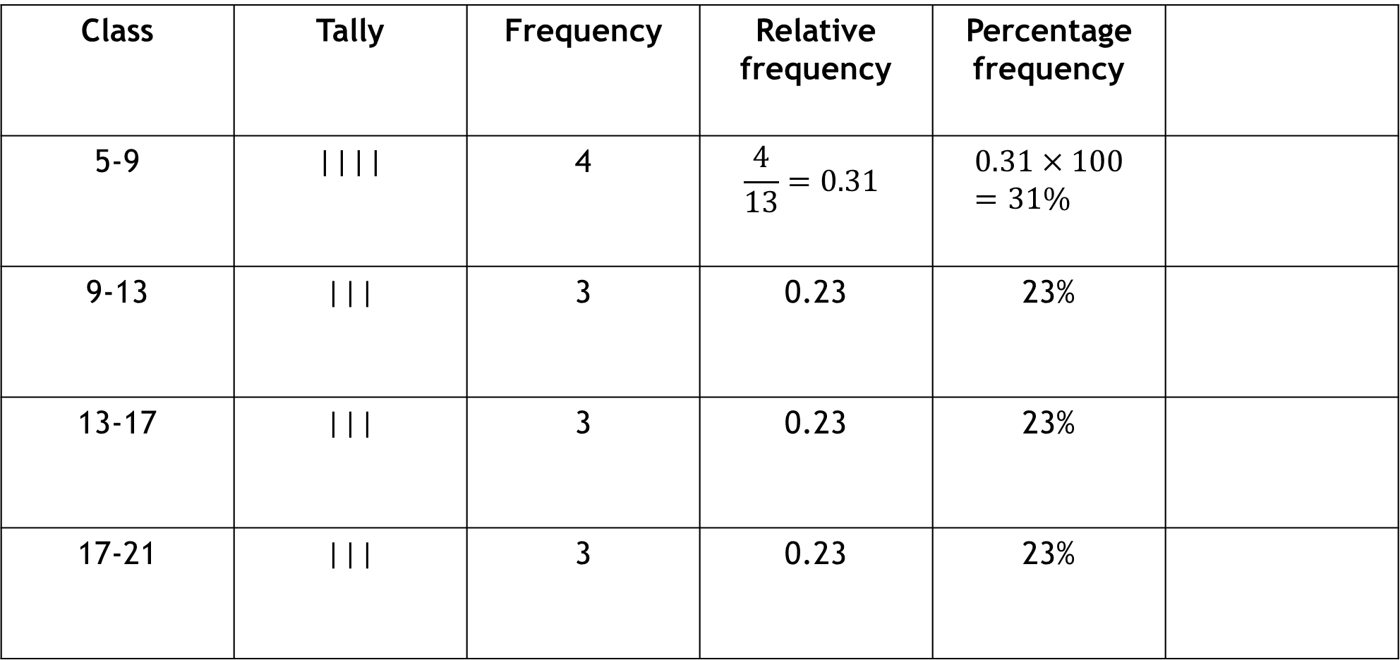
FD for Quantitative
Class | Tally | Frequency | Relative frequency | Percentage frequency
5-9 | |||| | 4 | $$\frac{4}{13}=0.31$$ | $$0.31×100=31\%$$
9-13 | ||| | 3 | 0.23 | 23%
13-17 | ||| | 3 | 0.23 | 23%
17-21 | ||| | 3 | 0.23 | 23%

Slide 20
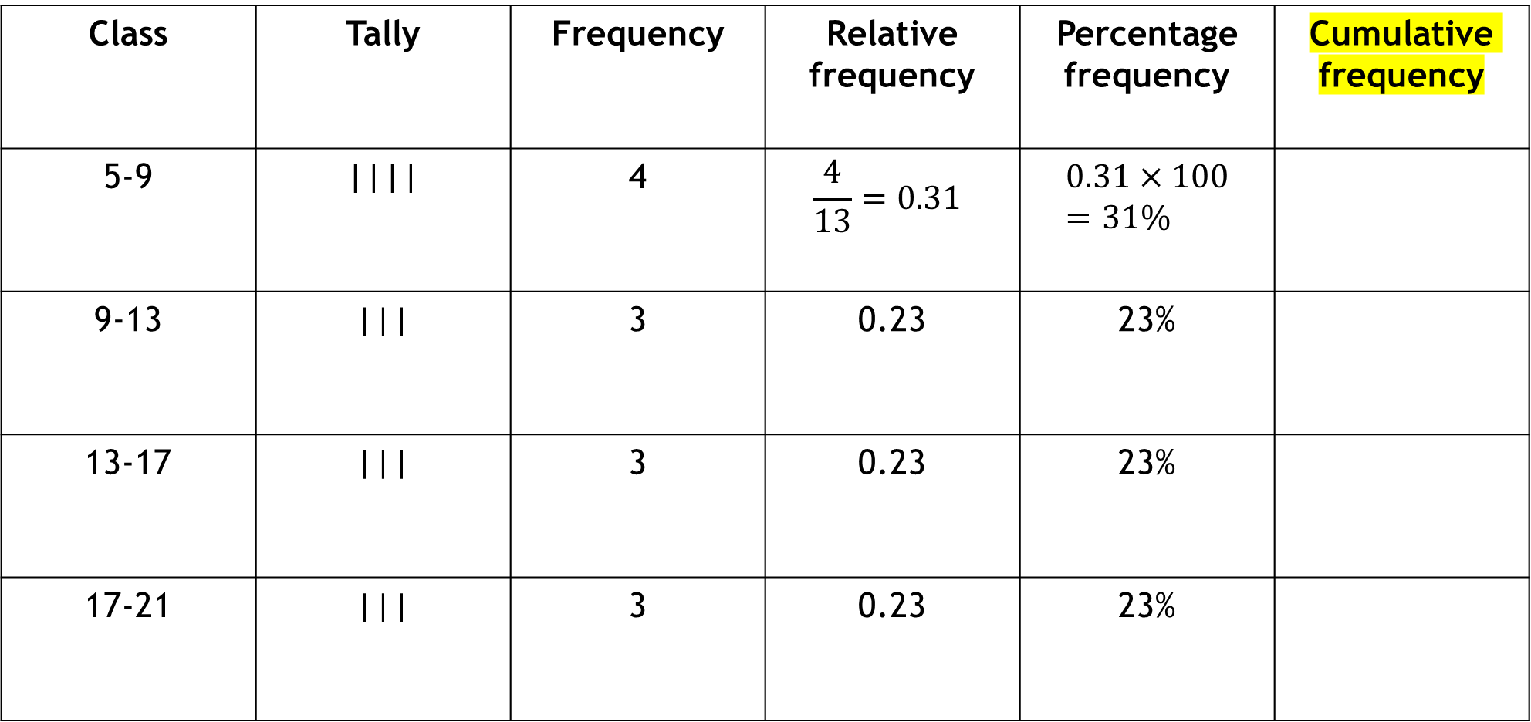
FD for Quantitative
Cumulative frequency: Cumulative frequency of a value is its frequency plus the frequencies of all smaller values.
Class | Tally | Frequency | Relative frequency | Percentage frequency | Cumulative frequency
5-9 | |||| | 4 | $$\frac{4}{13}=0.31$$ | $$0.31×100=31\%$$
9-13 | ||| | 3 | 0.23 | 23%
13-17 | ||| | 3 | 0.23 | 23%
17-21 | ||| | 3 | 0.23 | 23%

Slide 21
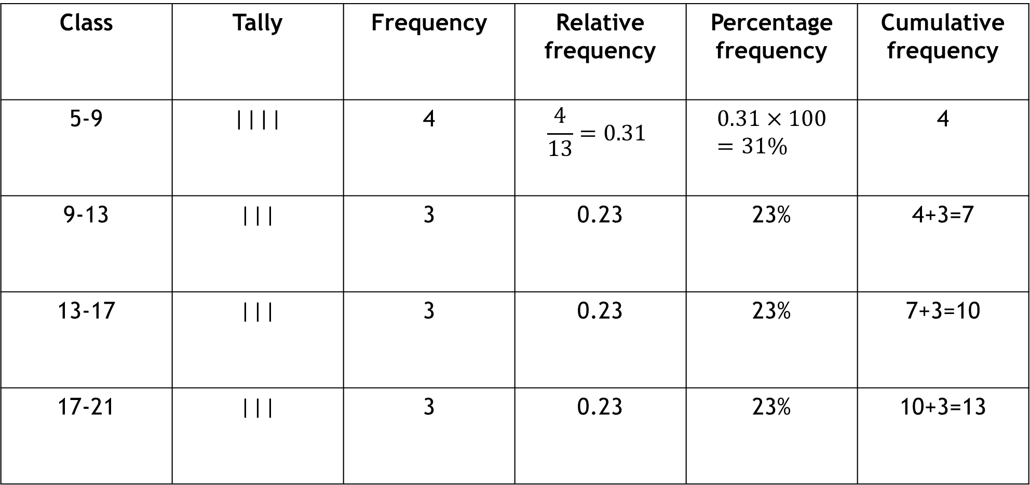
FD for Quantitative
Class | Tally | Frequency | Relative frequency | Percentage frequency | Cumulative frequency
5-9 | |||| | 4 | $$\frac{4}{13}=0.31$$ | $$0.31×100=31\%$$ | 4
9-13 | ||| | 3 | 0.23 | 23% | 4+3=7
13-17 | ||| | 3 | 0.23 | 23% | 7+3=10
17-21 | ||| | 3 | 0.23 | 23% | 10+3=13

Slide 22
Class Work
Weight (in KG) | Midpoint | Frequency | Relative frequency | Cumulative frequency | Relative Cumulative freq.
35-40 | 37.5 | 2 | 0.033
40-45 |  | 5 | 0.083
45-50 | 47.5 | 12
50-55 |  |  |  | 35
55-60 |  | 12
60-65 |  | 6
65-70 |  | 4
70-75 |  | 3 | 0.050

Slide 23
FD for Qualitative
Student, Student, Public service, Businessman, Day labor, Public service, Private service, Day labor, Student, Public service, Public service, Private service, Businessman, Day labor, Businessman, Private service, Businessman, Public service, Private service, Public service.
Class | Tally | Frequency
Businessman | |||| | 4
Day Labor | ||| | 3
Private service | |||| | 4
Public service | |||| | 6
Student | ||| | 3
Total |  | 20

Slide 24
Mathematical exercise
Text Book: Page 44 to 48 (29, 31, 35, 36, 39)
To access additional mathematical problems, please refer to the PDF lecture notes.

Slide 25
Thank You

